Slide 1
Anxiety
How to help yourself

Slide 2
How to help yourself…
Things you can do
Things you can think
What you can ask of others

Slide 3
Read
Books, books, and more books!

Slide 4
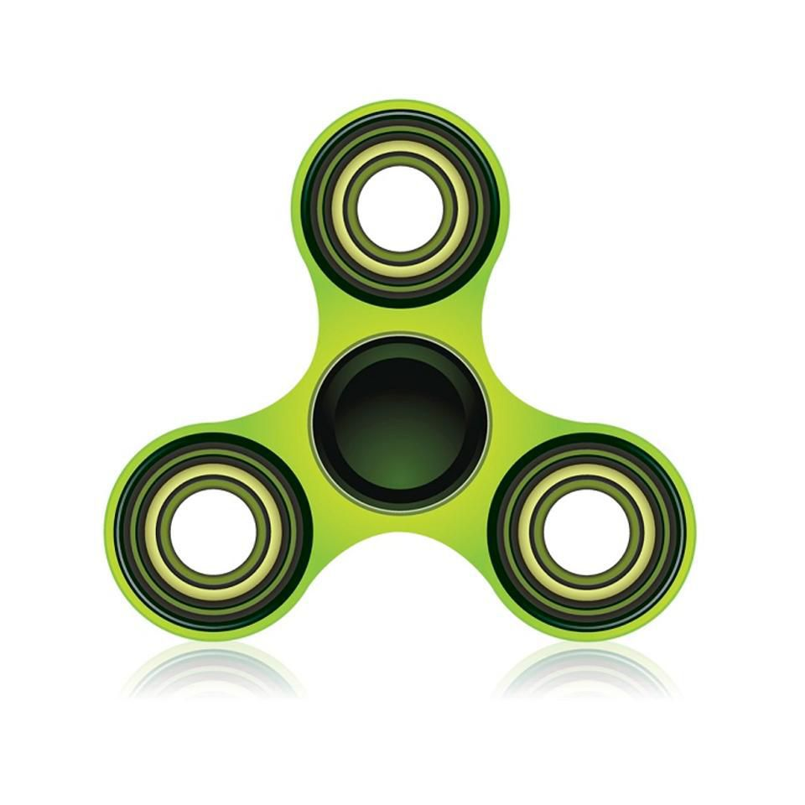
Fidgets
Paper clips, pencils, etc.

Slide 5
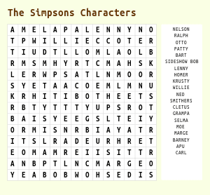
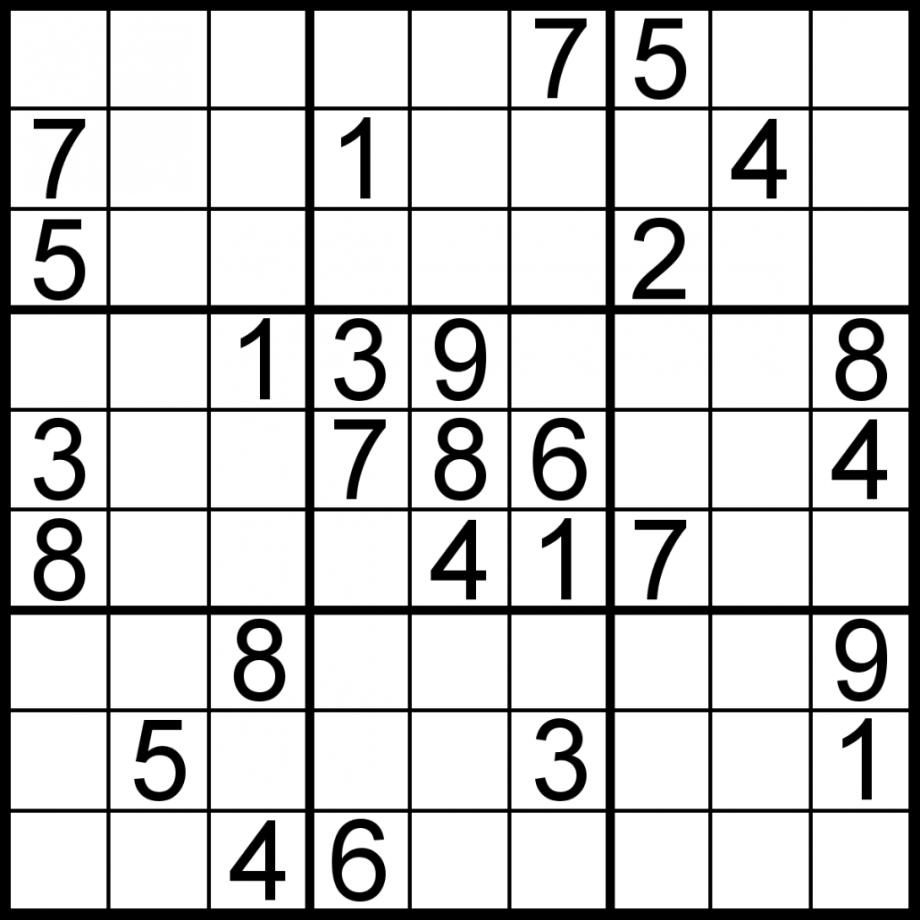
Solve puzzles
Distracts your mind!

Slide 6
Doodle
Anything is fine!

Slide 7
Playdough
There is no age limit!

Slide 8
Slinky
Best thing ever!

Slide 9
Handheld games
So many old ones around!

Slide 10
Meditate
Find a quiet place…

Slide 11
Music
Play, listen, sing…

Slide 12
Blow bubbles
Good for controlling rate of breath

Slide 13
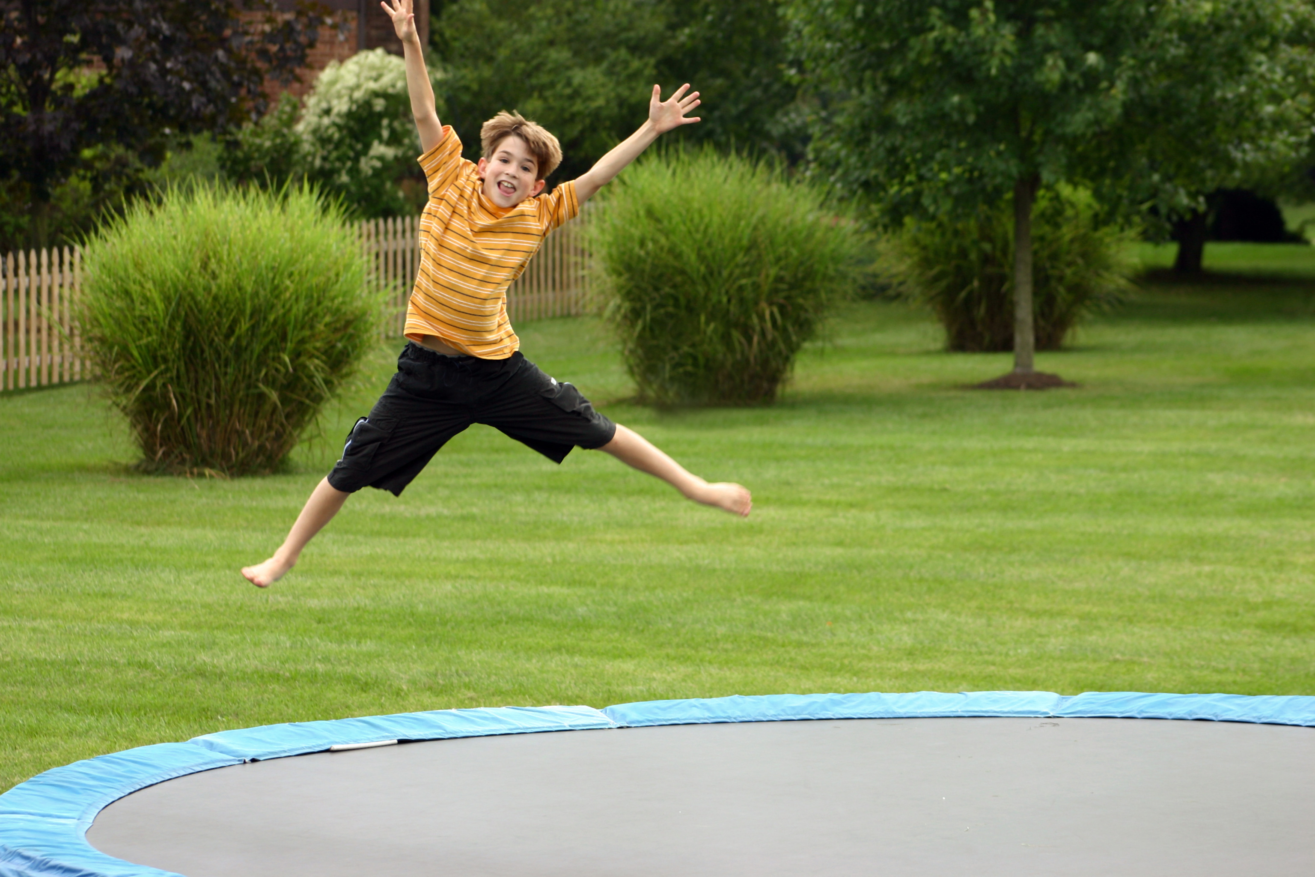
Exercise
Anything that gets you moving!

Slide 14
Animals
Walk, pet, brush, play…

Slide 15
Be productive
Cook, clean, etc.

Slide 16
Connect
With positive people

Slide 17
Laugh
Comics, movies, videos

Slide 18
Things you can THINK

Slide 19
I am a good and worthwhile person

Slide 20
I have so much to offer

Slide 21
All is well, right here, right now

Slide 22
I can achieve anything I want to achieve

Slide 23
I am in control of my life

Slide 24
I have a lot to be proud of

Slide 25
I care about others, I am needed and worthwhile

Slide 26
I am a likeable person and I like myself

Slide 27
I am a unique and special person

Slide 28
Things are getting better every day

Slide 29
I can treat myself gently and with the care I would give a close friend

Slide 30
I am learning what I need to do to take care of my body

Slide 31
I will look for the good this day can bring

Slide 32
I know I can master anything if I practice it continually

Slide 33
Things you can ask others…

Slide 34
Hel
Help me with my homework

Slide 35
Take a walk with me

Slide 36
Watch TV with me

Slide 37
Just listen

Slide 38
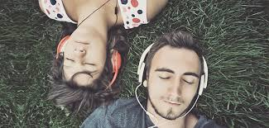
Just hangout

Slide 39
Make me laugh

Slide 40
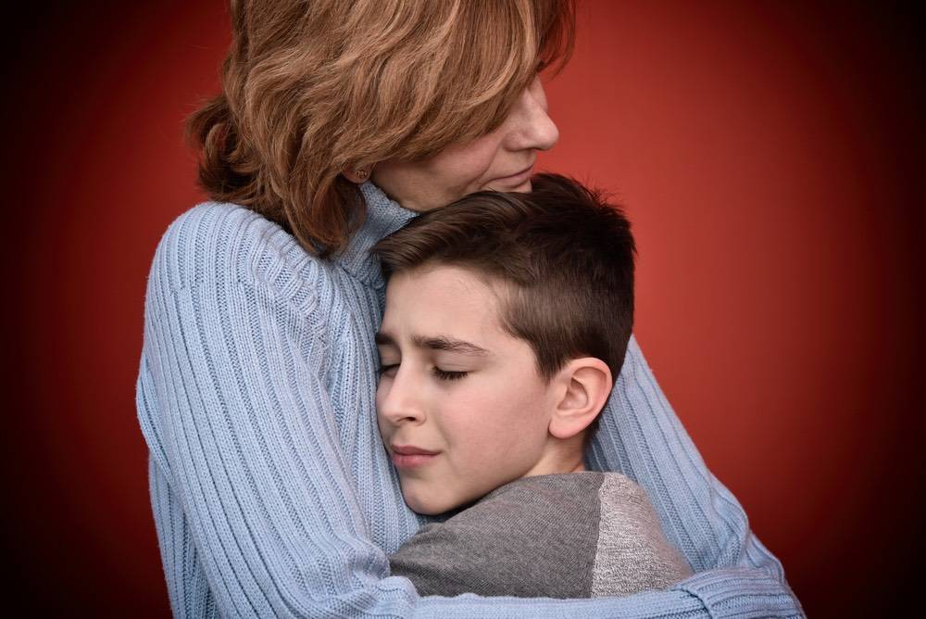
Give me a hug

Slide 41
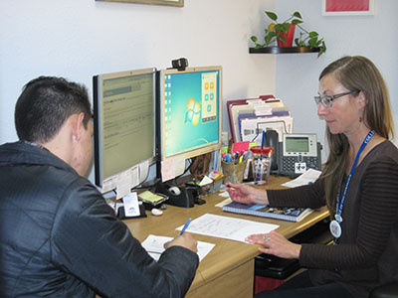
Help me ask for help

